Slide 1
Chapter 4: Global State and Snapshot Recording Algorithms
Ajay Kshemkalyani and Mukesh Singhal
Distributed Computing: Principles, Algorithms, and Systems
Cambridge University Press
CUP 2008
1 / 51

Slide 2
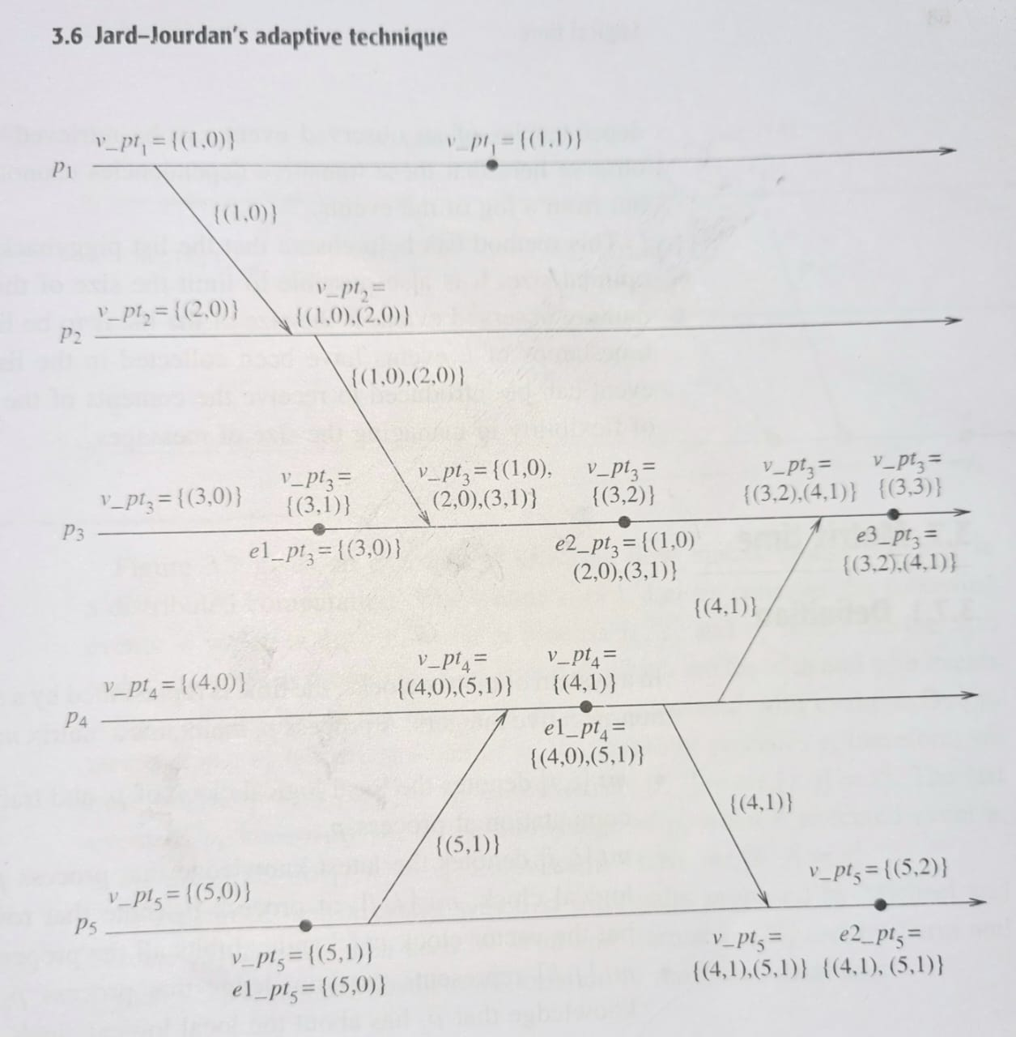

Slide 3
Introduction
Distributed Computing: Principles, Algorithms, and Systems
Recording the global state of a distributed system on-the-fly is an important paradigm.
The lack of globally shared memory, global clock and unpredictable message delays in a distributed system make this problem non-trivial.
This chapter first defines consistent global states and discusses issues to be addressed to compute consistent distributed snapshots.
Then several algorithms to determine on-the-fly such snapshots are presented for several types of networks.
CUP 2008
3 / 51

Slide 4
introduction
DS- no shared memory, communication is asynchronous
State of a Process-local memory , history of events that occurred
State of channel- set of messages sent , set of messages received
Global state- local states of its components
DS- checkpoints- periodically save and recover from failure
DS cannot record global state- no shared memory, global clock
Complete view of system – local state of process

Slide 5
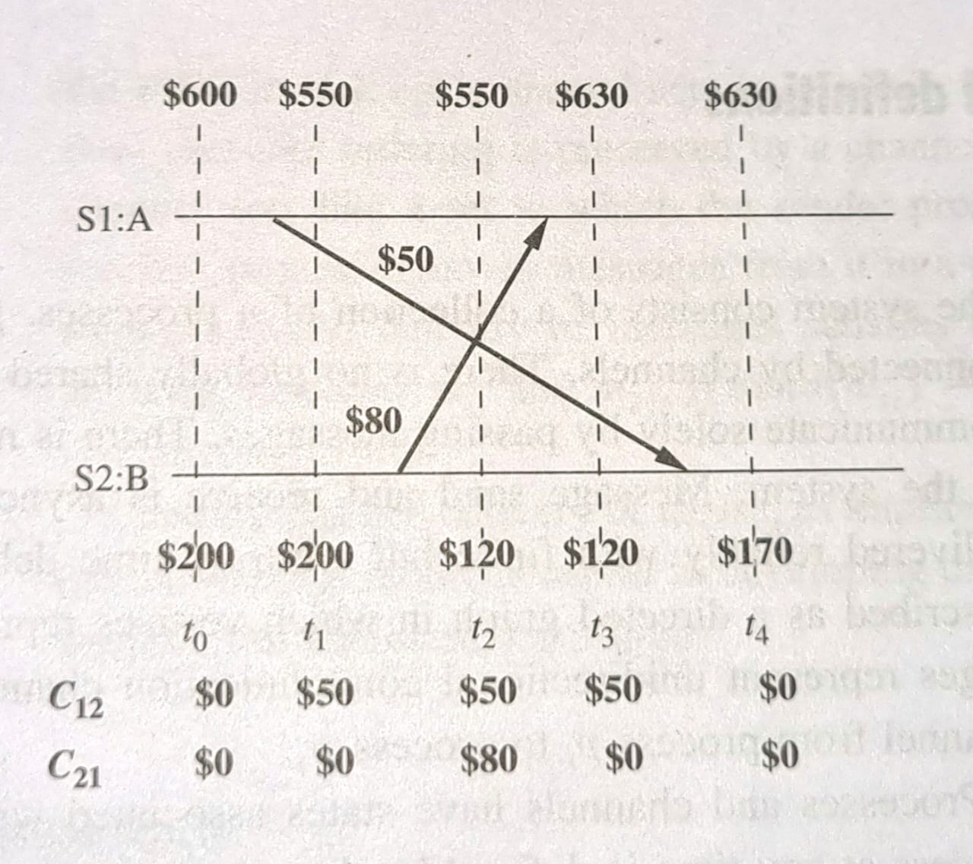
Example

Slide 6
Example Let S1 and S2 be two distinct sites of a distributed system which maintain bank accounts A and B. respectively.
A site refers to a process in this example. Let the communication channels from site S1 to Site S2 and from site S2 to site S1 be denoted by C12 and C21- respectively.
Consider the following sequence of actions, which are also illustrated in the timing diagram of Figure 4.1:
Time t0: Initially, Acount A-$600, Account B= $200, C2= $0,C2=$0.
Time t1: Site S1 initiates a transfer of $50 from Account A to Account B. Account A is decremented by $50 to $550 and a request for $50 credit to Account B is sent on Channel C12 to site S2. Account A= $550.Account B =$200, Cn =$50, C2L= $O.
Time t2: Site S2 initiates a transfer of $80 from Account B to Account A. Account B is decremented by $80 to $120 and a request for $80 credit to Account A is sent on Channel C21 to site S1. Account A=$550,Account B = $120, C12 = $50, C21 = $80.
Time t3: Site S1 receives the message for a $80 credit to Account A and updates Account A. Account A -$630, Account B= $120, Ci2=$50,C21=$0.
Time t4: Site S2 receives the message for a $50 credit to Account B and updates Account B. Account A = $630, Account B= $170, C1=$0,C2 =$0.

Slide 7
Suppose the local state of Account A is recorded at time t0 to show $600
and the local state of Account B and channels C12 and C21 are recorded at time t2 to show $120, $50, and $80, respectively.
Then the recorded global state shows $850 in the system.
An extra $50 appears in the system.
The reason for the inconsistency is that Account A's state was recorded before the $50 transfer to Account B using channel C12 was initiated, whereas channel C12’s state was recorded after the $50 transfer was initiated

Slide 8
System model
Distributed Computing: Principles, Algorithms, and Systems
The system consists of a collection of n processes p₁, p₂, ..., p_{n} that are connected by channels.
There are no globally shared memory and physical global clock and processes communicate by passing messages through communication channels.
C_{ij} denotes the channel from process p_{i} to process p_{j} and its state is denoted by SC_{ij} . Pi pj
The actions performed by a process are modeled as three types of events: Internal events,the message send event and the message receive event.
For a message m_{ij} that is sent by process p_{i} to process p_{j} , let send (m_{ij} ) and
rec (m_{ij} ) denote its send and receive events.
CUP 2008
8 / 51

Slide 9
System model
Distributed Computing: Principles, Algorithms, and Systems
At any instant, the state of process p_{i} , denoted by LS_{i} , is a result of the sequence of all the events executed by p_{i} till that instant.
For an event e and a process state LS_{i} , e∈LS_{i} iff e belongs to the sequence of events that have taken process p_{i} to state LS_{i} .
For an event e and a process state LS_{i} , e/∈LS_{i} iff e does not belong to the sequence of events that have taken process p_{i} to state LS_{i} .
For a channel C_{ij} , the following set of messages can be defined based on the local states of the processes p_{i} and p_{j}
Transit: transit(LS_{i} , LS_{j} ) = {m_{ij} |send (m_{ij} ) ∈ LS_{i ᴧ} rec (m_{ij} ) /∈ LS_{j} }
CUP 2008
9 / 51

Slide 10
Models of communication
Distributed Computing: Principles, Algorithms, and Systems
Recall, there are three models of communication: FIFO, non-FIFO, and Co.
In FIFO model, each channel acts as a first-in first-out message queue and thus, message ordering is preserved by a channel.
In non-FIFO model, a channel acts like a set in which the sender process adds messages and the receiver process removes messages from it in a random order.
A system that supports causal delivery of messages satisfies the following property: “For any two messages m_{ij} and m_{kj} , if send (m_{ij} ) −→ send (m_{kj} ), then rec (m_{ij} ) −→ rec (m_{kj} )”.
CUP 2008
10 / 51

Slide 11
Consistent global state
Distributed Computing: Principles, Algorithms, and Systems
The global state of a distributed system is a collection of the local states of the processes and the channels.
Notationally, global state GS is defined as,
⋃ ⋃
GS = { _{i} LS_{i} , _{i ,j} SC_{ij} }
A global state GS is a consistent global state iff it satisfies the following two conditions :
C1: send(m_{ij} )∈LS_{i} ⇒ m_{ij} ∈SC_{ij} ⊕ rec(m_{ij} )∈LS_{j} . (⊕ is Ex-OR operator.)
C2: send(m_{ij} )/∈LS_{i} ⇒ m_{ij} /∈SC_{ij} ∧ rec(m_{ij} )/∈LS_{j} .
CUP 2008
11 / 51

Slide 12
Interpretation in terms of cuts
Distributed Computing: Principles, Algorithms, and Systems
A cut in a space-time diagram is a line joining an arbitrary point on each process line that slices the space-time diagram into a PAST and a FUTURE.
A consistent global state corresponds to a cut in which every message received in the PAST of the cut was sent in the PAST of that cut.
Such a cut is known as a consistent cut.
For example, consider the space-time diagram for the computation illustrated in Figure 4.1.
Cut C1 is inconsistent because message m1 is flowing from the FUTURE to the PAST.
Cut C2 is consistent and message m4 must be captured in the state of channel C₂₁.
CUP 2008
12 / 51

Slide 13
Distributed Computing: Principles, Algorithms, and Systems
C₁
C₂
_{e} 3
_{e} 4
1 2
p
^{e}1 ^{e}1
1
1
1
m ₁
_{e} 2
_{e} 3
4
_{e}1
e₂
m
m₅
p₂
2
2
2
4
_{e} 1
_{e} 2
m₂
_{e} 3
_{e} 4
_{e}5
p
3
3
3
3
3
3
_{e}1
m₃
_{e} 2
p ₄
4
4
time
Figure 4.1: An Interpretation in Terms of a Cut.
CUP 2008
13 / 51

Slide 14
Issues in recording a global state
Distributed Computing: Principles, Algorithms, and Systems
Snapshot – future time when snapshot must be take and broadcast to all process
Snapshot of channel- all msgs received after taking snapshot by pj
The following two issues need to be addressed:
I1: How to distinguish between the messages to be recorded in the snapshot from those not to be recorded.
-Any message that is sent by a process before recording its snapshot, must be recorded in the global snapshot (from C1).
-Any message that is sent by a process after recording its snapshot, must not be recorded in the global snapshot (from C2).
I2: How to determine the instant when a process takes its snapshot.
-A process p_{j} must record its snapshot before processing a message
m_{ij} that was sent by process p_{i} after recording its snapshot.
CUP 2008
14 / 51

Slide 15
Snapshot algorithms for FIFO channels
Distributed Computing: Principles, Algorithms, and Systems
Chandy-Lamport algorithm
The Chandy-Lamport algorithm uses a control message, called a marker
whose role in a FIFO system is to separate messages in the channels.
After a site has recorded its snapshot, it sends a marker, along all of its outgoing channels before sending out any more messages.
A marker separates the messages in the channel into those to be included in the snapshot from those not to be recorded in the snapshot.
A process must record its snapshot no later than when it receives a marker on any of its incoming channels.

Slide 16
Chandy-Lamport algorithm
Distributed Computing: Principles, Algorithms, and Systems
The algorithm can be initiated by any process by executing the “Marker Sending Rule” by which it records its local state and sends a marker on each outgoing channel.
A process executes the “Marker Receiving Rule” on receiving a marker. If the process has not yet recorded its local state, it records the state of the channel on which the marker is received as empty and executes the “Marker Sending Rule” to record its local state.
The algorithm terminates after each process has received a marker on all of its incoming channels.
All the local snapshots get disseminated to all other processes and all the processes can determine the global state.

Slide 17
Chandy-Lamport algorithm
Distributed Computing: Principles, Algorithms, and Systems
Marker Sending Rule for process i
Process i records its state.
For each outgoing channel C on which a marker has not been sent, i sends a marker along C before i sends further messages along C.
1
2
Marker Receiving Rule for process j
On receiving a marker along channel C:
if j has not recorded its state then
Record the state of C as the empty set Follow the “Marker Sending Rule”
else
Record the state of C as the set of messages received along C after j’s state was recorded and before j received the marker along C

Slide 18
Correctness and Complexity
Distributed Computing: Principles, Algorithms, and Systems
Correctness
Due to FIFO property of channels, it follows that no message sent after the marker on that channel is recorded in the channel state. Thus, condition C2 is satisfied.
When a process p_{j} receives message m_{ij} that precedes the marker on channel C_{ij} , it acts as follows: If process p_{j} has not taken its snapshot yet, then it includes m_{ij} in its recorded snapshot. Otherwise, it records m_{ij} in the state of the channel C_{ij} . Thus, condition C1 is satisfied.
Complexity
The recording part of a single instance of the algorithm requires O(e) messages and O(d ) time, where e is the number of edges in the network and d is the diameter of the network.

Slide 19
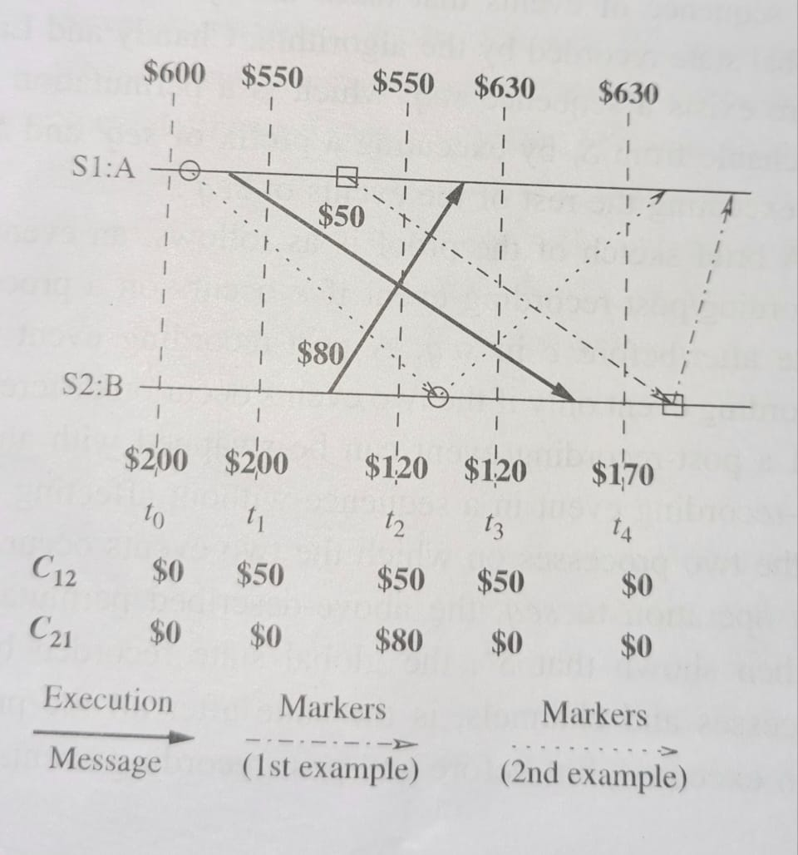
Properties of recorded global state

Slide 20
(Markers shown using dashed-and-dotted arrows.) Let site S1algorithm just after t1. Site S1 records its local state (account A=$550) and sends a marker to site S2.
The marker is received by site S2 after t4. When site S2 receives the marker, it records its local state (account B= $170). the state of channel C12 as $0, and sends a marker along channel C21.
When site S1 receives this marker, it records the state of channel c21 as $80.
The $800 amount in the system is conserved in the recorded global state. A = $550, B- $170, C12 = $0, C21 = $

Slide 21
(Markers shown using dotted arrows.) Let site S1 initiate the algorithm just after t0 and before sending the $50 for S2.
Site S1 records its local state (account A = $600) and sends a marker to site $2.
The marker is received by site S2 between t2 and t3. When site S2 receives the marker, it records its local state (account B= $120) the state of channel C12 as $O, and sends a marker along channel C21.
When site S1 receives this marker, it records the state of the channel C21 as $80.
The $800 amount system it records the state of channel in the is conserved in the recorded
A= $600, B = $120, C12 = $0, C21 = $80.

Slide 22
Spezialetti-Kearns algorithm
Distributed Computing: Principles, Algorithms, and Systems
There are two phases in obtaining a global snapshot: locally recording the snapshot at every process and distributing the resultant global snapshot to all the initiators.
Efficient snapshot recording
In the Spezialetti-Kearns algorithm, a markers carries the identifier of the initiator of the algorithm. Each process has a variable master to keep track of the initiator of the algorithm.
A key notion used by the optimizations is that of a region in the system. A region encompasses all the processes whose master field contains the identifier of the same initiator.
When the initiator’s identifier in a marker received along a channel is different from the value in the master variable, the sender of the marker lies in a different region.
The identifier of the concurrent initiator is recorded in a local variable
id -border -set.

Slide 23
The state of the channel is recorded just as in the Chandy-Lamport algorithm (including those that cross a border between regions).
Distributed Computing: Principles, Algorithms, and Systems
Snapshot recording at a process is complete after it has received a marker along each of its channels.
After every process has recorded its snapshot, the system is partitioned into as many regions as the number of concurrent initiations of the algorithm.
Variable id -border -set at a process contains the identifiers of the neighboring regions.
Efficient dissemination of the recorded snapshot
In the snapshot recording phase, a forest of spanning trees is implicitly created in the system. The initiator of the algorithm is the root of a spanning tree and all processes in its region belong to its spanning tree.

Slide 24
Efficient dissemination of the recorded snapshot
Distributed Computing: Principles, Algorithms, and Systems
If p_{i} receives its first marker from p_{j} then process p_{j} is the parent of process
p_{i} in the spanning tree.
When an intermediate process in a spanning tree has received the recorded states from all its child processes and has recorded the states of all incoming channels, it forwards its locally recorded state and the locally recorded states of all its descendent processes to its parent.
When the initiator receives the locally recorded states of all its descendents from its children processes, it assembles the snapshot for all the processes in its region and the channels incident on these processes.
The initiator exchanges the snapshot of its region with the initiators in adjacent regions in rounds.
The message complexity of snapshot recording is O(e) irrespective of the number of concurrent initiations of the algorithm. The message complexity of assembling and disseminating the snapshot is O(rn² ) where r is the number of concurrent initiations.

Slide 25
Venkatesan’s incremental snapshot algorithm
Many applications require repeated collection of global snapshots of the system.
For example- recovery algorithms with synchronous checkpointing need
to advance their checkpoints periodically.
. Venkatesan [32] proposed the following efficient approach:
execute an algorithm to record an incremental snapshot since the most recent snapshot was taken and combine it with the most recent snapshot to obtain the latest snapshot of the system.
The incremental snapshot algorithm of Venkatesan [32] modifies the global snapshot
algorithm of Chandy–Lamport to save on messages when computation messages
are sent only on a few of the network channels, between the recording
of two successive snapshots
The incremental snapshot algorithm assumes bidirectional FIFO channels,
the presence of a single initiator, a fixed spanning tree in the network, and
four types of control messages: init_snap, regular, and ack. init_snap, and
snap_completed messages traverse the spanning tree edges

Slide 26
Venkatesan’s incremental snapshot algorithm
snapshots are assigned version numbers and all algorithm messages carry this version number.
The initiator notifies all the processes the version number of the new snapshot by sending init_snap messages along the spanning tree edges.
A process follows the “marker sending rule” when it receives this notification or when it receives a regular message with a new version number. The “marker sending rule” is modified so that the process sends regular messages along only those channels on which it has sent computation messages since the previous snapshot, and the process waits for ack messages in response to these regular messages.
When a leaf process in the spanning tree receives all the ack messages it expects, it sends a snap_completed message to its parent process.
When a non-leaf process in the spanning tree receives all the ack messages it expects, as well as a snap_completed message from each of its child processes, it sends a snap_completed message to its parent process.
The algorithm terminates when the initiator has received all the ack messages it expects, as well as a snap_completed message from each of its child processes.

Slide 27
Helary’s snapshot algorithm
Helary’s snapshot algorithm [12] incorporates the concept of message waves
in the Chandy–Lamport algorithm.
A wave is a flow of control messages such that every process in the system is visited exactly once by a wave control message, and at least one process in the system can determine when this flow of control messages terminates.
A wave is initiated after the previous wave terminates.
A process begins recording the local snapshot when it is visited by the wave control message.
In Helary’s algorithm, the “marker sending rule” is executed when a control
message belonging to the wave flow visits the process.
The process then forwards a control message to other processes, depending on the wave traversal structure, to continue the wave’s progression.

Slide 28
Helary’s snapshot algorithm
The “marker receiving rule” is modified so that if the process has not recorded its state when a marker is received on some channel, the “marker receiving rule” is not executed and no messages received after the marker on this channel are processed until the control message belonging to the wave flow visits the process.
Thus, each process follows the “marker receiving rule” only after it is visited by a control message belonging to the wave.
each process maintains two vectors, SENT and RECD.
The ith elements of these vectors indicate the number of messages
sent to/received from process i, respectively, since the previous visit of a
wave control message.
The wave control messages carry a global abstract counter vector whose ith entry indicates the number of messages in transit to process i.
These entries in the vector are updated using the SENT and RECD vectors at each node visited.
When the control wave terminates, the number of messages in transit to each process as recorded in the snapshot is known.

Slide 29
Snapshot algorithms for non-FIFO channels
Distributed Computing: Principles, Algorithms, and Systems
In a non-FIFO system, a marker cannot be used to delineate messages into those to be recorded in the global state from those not to be recorded in the global state.
In a non-FIFO system, either some degree of inhibition or piggybacking of control information on computation messages to capture out-of-sequence messages.

Slide 30
Lai-Yang algorithm
Distributed Computing: Principles, Algorithms, and Systems
The Lai-Yang algorithm fulfills this role of a marker in a non-FIFO system by using a coloring scheme on computation messages that works as follows:
1
Every process is initially white and turns red while taking a snapshot. The equivalent of the “Marker Sending Rule” is executed when a process turns red.
Every message sent by a white (red) process is colored white (red).
Thus, a white (red) message is a message that was sent before (after) the sender of that message recorded its local snapshot.
Every white process takes its snapshot at its convenience, but no later than the instant it receives a red message.
2
3
4

Slide 31
Lai-Yang algorithm
Distributed Computing: Principles, Algorithms, and Systems
4
Every white process records a history of all white messages sent or received by it along each channel.
When a process turns red, it sends these histories along with its snapshot to the initiator process that collects the global snapshot.
The initiator process evaluates transit(LS_{i} , LS_{j} ) to compute the state of a channel C_{ij} as given below:
SC_{ij} = white messages sent by p_{i} on C_{ij} − white messages received by p_{j} on
Cij
= {send (m_{ij} )|send (m_{ij} ) ∈ LS_{i} } − {rec (m_{ij} )|rec (m_{ij} ) ∈ LS_{j} }.
5
6

Slide 32
Li et al.’s algorithm
In addition, the algorithm is not concerned with the contents of computation messages and the state of a channel is computed as the number of messages in transit in the channel.
A process maintains two counters for each incident channel to record the number of messages sent and received on the channel and reports these counter values with its snapshot to the initiator.
This simplification is combined with the incremental technique to compute channel states, which reduces the size of message histories to be stored and transmitted.
The initiator computes the state of Cij as:
(the number of messages in Cij in the previous snapshot) + (the number of messages sent on Cij since the last snapshot at process pi) − (the number of messages received on Cij since the last snapshot at process pj ).

Slide 33
All messages sent after a local snapshot recording are tagged by a tuple <init_id,MKNO >, where init_id is the initiator’s identifier and MKNO is
the sequence number of the algorithm’s most recent invocation by initiator
init_id;
The initiator of the algorithm maintains a variable TRANSITij for the number of messages in transit in the channel from process pi to process pj , as recorded in the previous snapshot.

Slide 34
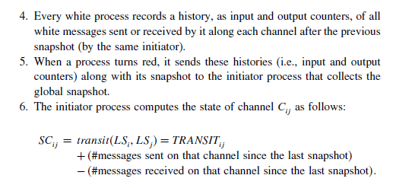
If the initiator initiates a snapshot before the completion of the previous snapshot, it is possible that some process may get a message with a lower sequence number after participating in a snapshot initiated later. In this case, the algorithm uses the snapshot with the higher sequence number to also create the snapshot for the lower sequence number.

Slide 35
Mattern’s algorithm
Distributed Computing: Principles, Algorithms, and Systems
Mattern’s algorithm is based on vector clocks and assumes a single initiator process and works as follows:
1
The initiator “ticks” its local clock and selects a future vector time s at which it would like a global snapshot to be recorded. It then broadcasts this time s and freezes all activity until it receives all acknowledgements of the receipt of this broadcast.
When a process receives the broadcast, it remembers the value s and returns an acknowledgement to the initiator.
After having received an acknowledgement from every process, the initiator increases its vector clock to s and broadcasts a dummy message to all processes.
The receipt of this dummy message forces each recipient to increase its clock to a value ≥ s if not already ≥ s.
Each process takes a local snapshot and sends it to the initiator when (just before) its clock increases from a value less than s to a value ≥ s.
The state of C_{ij} is all messages sent along C_{ij} , whose timestamp is smaller than s and which are received by p_{j} after recording LS_{j} .
2
3
4
5
6

Slide 36
Mattern’s algorithm
Distributed Computing: Principles, Algorithms, and Systems
A termination detection scheme for non-FIFO channels is required to detect that no white messages are in transit.
One of the following schemes can be used for termination detection:
First method:
Each process i keeps a counter cntr_{i} that indicates the difference between the number of white messages it has sent and received before recording its snapshot.
It reports this value to the initiator process along with its snapshot and forwards all white messages, it receives henceforth, to the initiator.
Σ
Snapshot collection terminates when the initiator has received _{i} cntr_{i}
number of forwarded white messages.

Slide 37
Mattern’s algorithm
Distributed Computing: Principles, Algorithms, and Systems
Second method:
Each red message sent by a process carries a piggybacked value of the number of white messages sent on that channel before the local state recording.
Each process keeps a counter for the number of white messages received on each channel.
A process can detect termination of recording the states of incoming channels when it receives as many white messages on each channel as the value piggybacked on red messages received on that channel.

Slide 38
Snapshots in a causal delivery system
Distributed Computing: Principles, Algorithms, and Systems
The causal message delivery property CO provides a built-in message synchronization to control and computation messages.
Two global snapshot recording algorithms, namely, Acharya-Badrinath and Alagar-Venkatesan exist that assume that the underlying system supports causal message delivery.
In both these algorithms recording of process state is identical and proceed as follows :
An initiator process broadcasts a token, denoted as token, to every process including itself.
Let the copy of the token received by process p_{i} be denoted token_{i} .
A process p_{i} records its local snapshot LS_{i} when it receives token_{i} and sends the recorded snapshot to the initiator.
The algorithm terminates when the initiator receives the snapshot recorded by each process.

Slide 39
Snapshots in a causal delivery system
Distributed Computing: Principles, Algorithms, and Systems
Correctness
For any two processes p_{i} and p_{j} , the following property is satisfied:
send (m_{ij} ) /∈ LS_{i} ⇒ rec (m_{ij} ) /∈ LS_{j} .
This is due to the causal ordering property of the underlying system as explained next.
◮ Let a message mij be such that rec(tokeni ) −→ send (mij ).
◮ Then send (tokenj ) −→ send (mij ) and the underlying causal ordering property ensures that rec(tokenj ), at which instant process pj records LSj , happens before rec(mij ).
◮ Thus, mij whose send is not recorded in LSi , is not recorded as received in LSj .
Channel state recording is different in these two algorithms and is discussed next.

Slide 40
Channel state recording in Acharya-Badrinath algorithm
Distributed Computing: Principles, Algorithms, and Systems
Each process p_{i} maintains arrays SENT_{i} [1, ...N ] and RECD_{i} [1, ..., N ]. SENT_{i} [j] is the number of messages sent by process p_{i} to process p_{j} . RECD_{i} [j] is the number of messages received by process p_{i} from process p_{j} . Channel states are recorded as follows:
When a process p_{i} records its local snapshot LS_{i} on the receipt of token_{i} , it includes arrays RECD_{i} and SENT_{i} in its local state before sending the snapshot to the initiator.

Slide 41
Channel state recording in Acharya-Badrinath algorithm
Distributed Computing: Principles, Algorithms, and Systems
When the algorithm terminates, the initiator determines the state of channels as follows:
The state of each channel from the initiator to each process is empty.
The state of channel from process p_{i} to process p_{j} is the set of messages whose sequence numbers are given by {RECD_{j} [i ] + 1, . . . , SENT_{i} [j]}.
Complexity:
This algorithm requires 2n messages and 2 time units for recording and assembling the snapshot, where one time unit is required for the delivery of a message.
If the contents of messages in channels state are required, the algorithm requires 2n messages and 2 time units additionally.

Slide 42
Channel state recording in Alagar-Venkatesan algorithm
Distributed Computing: Principles, Algorithms, and Systems
A message is referred to as old if the send of the message causally precedes the send of the token.
Otherwise, the message is referred to as new.
In Alagar-Venkatesan algorithm channel states are recorded as follows:
1
When a process receives the token, it takes its snapshot, initializes the state of all channels to empty, and returns Done message to the initiator. Now onwards, a process includes a message received on a channel in the channel state only if it is an old message.
After the initiator has received Done message from all processes, it broadcasts a Terminate message.
A process stops the snapshot algorithm after receiving a Terminate message.
2
3
28 / 51

Slide 43
Distributed Computing: Principles, Algorithms, and Systems
Algorithms
Features
Chandy- Lamport | Baseline algorithm. Requires FIFO channels. O(e) messages to record snapshot and O(d ) time.
Spezialetti- Kearns | supports concurrent initiators, efficient assembly and distribution of a snapshot. Assumes bidirectional channels. O(e) messages to record, O(rn² ) messages to assemble and distribute snapshot.
Lai-Yang | Works for non-FIFO channels. Markers piggybacked on computation messages. Message history required to compute channel states.
Li et al. | Small message history needed as channel states are computed incrementally.
Mattern | No message history required. Termination detection required to compute channel states.
Acharya- Badrinath | Requires causal delivery support, Centralized computation of channel states, Channel message contents need not be known. Requires 2n messages, 2 time units.
Alagar-Venkatesan | Requires causal delivery support, Distributed computation of channel states. Requires 3n messages, 3 time units, small messages.
n = # processes, u = # edges on which messages were sent after previous snapshot, e = # channels, d is the diameter of the network, r = # concurrent initiators.

